Slide 1
Thermoelectric Effects

Slide 2

Joule Heating
Consider any material that has a voltage potential difference across it (e.g. wire)
V⁺
N (# of e⁻)
V⁻
If we do an energy balance on the system, we can see that a change in the internal energy is caused by the decrease in voltage potential as electrons move from low voltage to high voltage
Remember conventional current goes from high to low, but electrons flow in the opposite direction
Since V⁺ > V⁻ then there is always a lost of energy

Slide 3

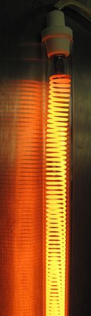

Joule Heating
If we substitute this equation into the 1st Law energy balance and put it in rate form, we get:
Or more commonly written as:
This shows that the drop in electrical potential energy as current passes through a material due to a voltage difference will create heat that will leave the material.
This phenomena is called ___Joule____ or ohmic (resistance) heating.

Slide 4

Joule Heating
What factors affect heat generation?
We can see that high voltage difference and/or high currents can produce large amounts of heat.
Note that the resistance of the material will affect voltage or current (remember Ohm’s Law: V=IR)
If we have high voltage, then low resistance is best.
Recall that the resistance of a given piece of material depends on its geometry and its material properties.
Thermal properties of the material will also have an effect of heat dissipation from the heating element.
⍴ is the resistivity of the material (Ωm), L is the length of the material, and A is the cross-sectional area of the material.

Slide 5
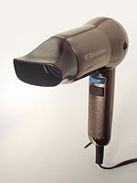
Class Problem
Example 1
A hair dryer is designed to output 2000 W of heat by using a 90 V source. If the heating coil is composed of nichrome (nickel-iron-chromium alloy) with a resistivity of 1.10 x 10⁻⁶ Ω-m and a diameter of 0.4 mm, how long must the nichrome wire be?

Slide 6
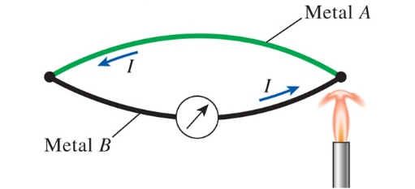
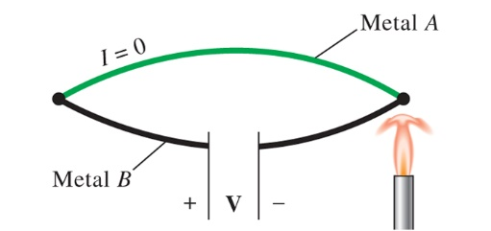
Thermoelectric Power Generator
Recall the purpose of a heat engine:
Converts heat into work
Consider two different metals joined at both ends to create a closed circuit
If there is a temperature difference between the two junctions, then a current flows through the circuit
If we break the circuit, current cannot flow, but a voltage difference is generated

Slide 7
Seebeck Effect
The Seebeck effect describes the voltage potential generation due to a temperature difference across two junctions of two conjoined different metals
Named after Thomas Seebeck for his discovery in 1821
There are two major applications of the Seebeck effect:
Temperature measurement
Power generation
A thermoelectric device is any device that operates using a thermoelectric circuit which incorporates thermal and electrical effects

Slide 8

Seebeck Effect: Temperature Measurement
If we break the circuit we create a voltage difference that is proportional to the temperature difference.
If we measure the voltage difference, we can determine the temperatures.
This is the working principles behind thermocouples.
There are many different types of thermocouples.
K-type (chromel-alumel) are the most common with a sensitivity of 41μV/ºC

Slide 9
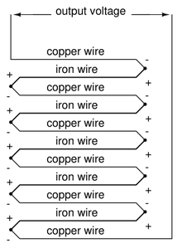
Seebeck Effect: Temperature Measurement
As you can see thermocouples generate small voltages per degree change in temperature.
But what if we need to measure a very small temperature difference (e.g. in mK).
We put a bunch of thermocouple devices in series to produce a thermopile.
Commonly used in applications where heats of reaction are being measured (e.g. concentrations of dilute species).

Slide 10

Seebeck Coefficient
We can pair up specific metals to change the sensitivity of a thermocouple device.
The Seebeck coefficient is material property that represents the induced voltage in response to a temperature difference across the material.
When we combine two different materials we can identify the expected voltage difference or temperature difference.
The Seebeck coefficient is relative value (since measuring it will create additional thermoelectric effects) and material values are compared to platinum (S_{Pt} = 0 μV/K).
The voltage gradient will point in the opposite direction of the temperature gradient.

Slide 11
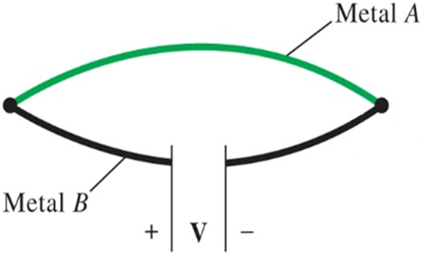
Class Problem
Example 2
A bismuth-antimony thermocouple reads a voltage difference of 0.1 mV. The Seebeck coefficients of bismuth and antimony are -72 μV/K and 47 +μV/K, respectively. If the temperature of the reference junction is known to be 22ºC, what is the temperature of the measuring junction?
22ºC

Slide 12
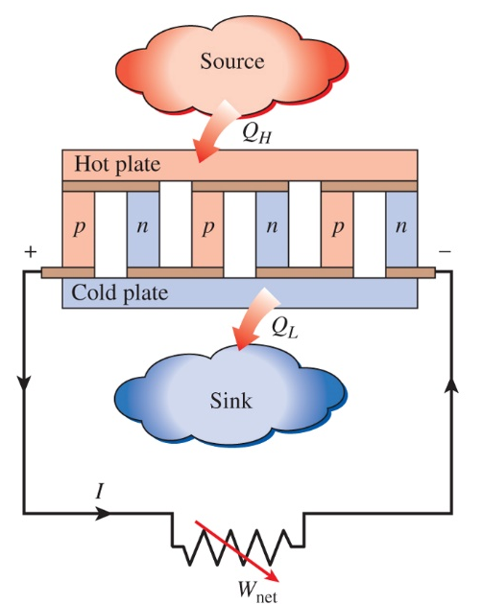
Thermoelectric Generator
A thermoelectric generator absorbs heat from a high-temperature source and rejects heat to a low-temperature sink; the difference is the produced electrical work.
Behaves like a heat engine with electrons serving as the “working fluid”.
Like a heat engine, the efficiency of the device is limited by the temperatures of the source and sink.
The presence of an irreversibility (resistance) keeps the actual efficiency below the Carnot efficiency.
Used in various applications
Low power applications
Limited fuel source applications (e.g. space exploration)
Waste heat recovery

Slide 13
Class Problem
Example 3
The Mars Curiosity Rover uses a radioisotope thermoelectric generator (RTG) which uses the heat from nuclear decay to generate electricity. Curiosity uses 4.8 kg of plutonium-238 dioxide which has a power density of 0.54 W/g. The average temperature of the heat source is 550ºC and the average temperature of the external sink is 230ºC. What is the maximum rate of power production for this thermoelectric generator?
Curiosity actually produces 110 W of electrical power and outputs 2 kW of heat waste. What is the actual thermal efficiency of the RTG?
**²³⁸Pu has a half-life of 87.7 years; which means the power output will decrease by 0.787% per year

Slide 14
Peltier Effect
Consider the thermoelectric generator that produces electrical work in the presence of a temperature difference.
What if we powered the device by means of an external voltage?
We could drive the heat transfer in the opposite direction (like a refrigerator or heat pump).
Thermoelectric refrigerators are driven by the Peltier effect.
Compared to vapor-compression refrigeration cycles, Peltier coolers are smaller, quieter, simpler, and more reliable, but they have low COPs.

Slide 15
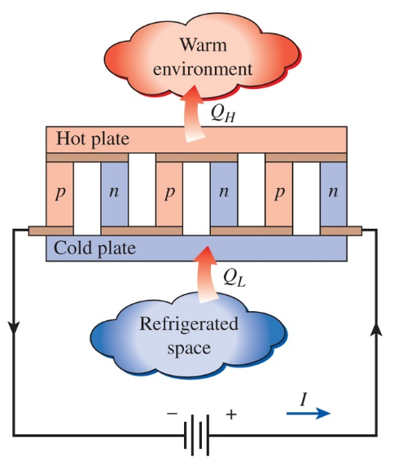
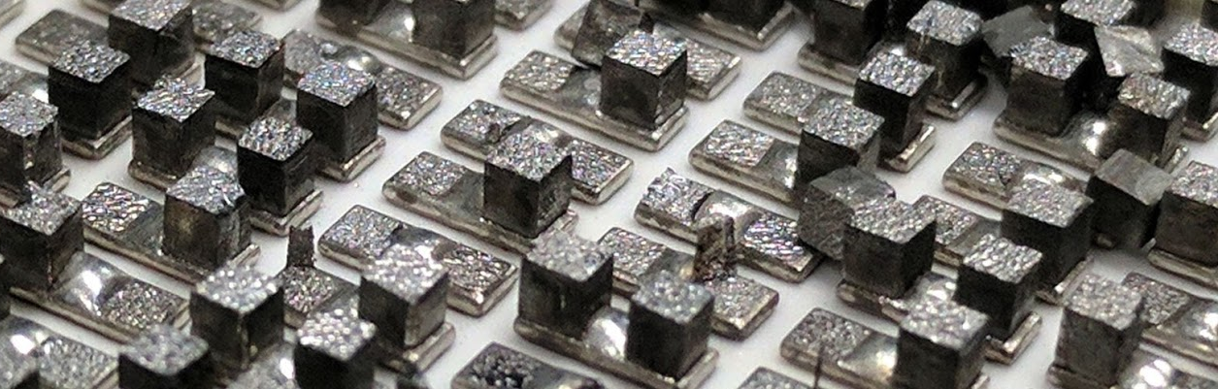
Peltier Coolers
If we were to look inside of a Peltier cooler, we would see numerous 2-column pairs.
One column would be n-type (heavily doped with extra electrons) and the other p-type (doped to create extra vacancies).
These alternating columns are arranged in series.
When a current passes through it draws heat away from the cold side and rejects it to the warm side.
Inside of Peltier cooler (top plate removed; some columns were damaged during removal process)
University of Utah

Slide 16
Class Problem
Example 4
A Peltier cooler uses 50 W of power to absorb 500 W of heat from a cold temperature source. If the external warm temperature is 85ºF, what is the coldest temperature the source could be?

